Slide 1
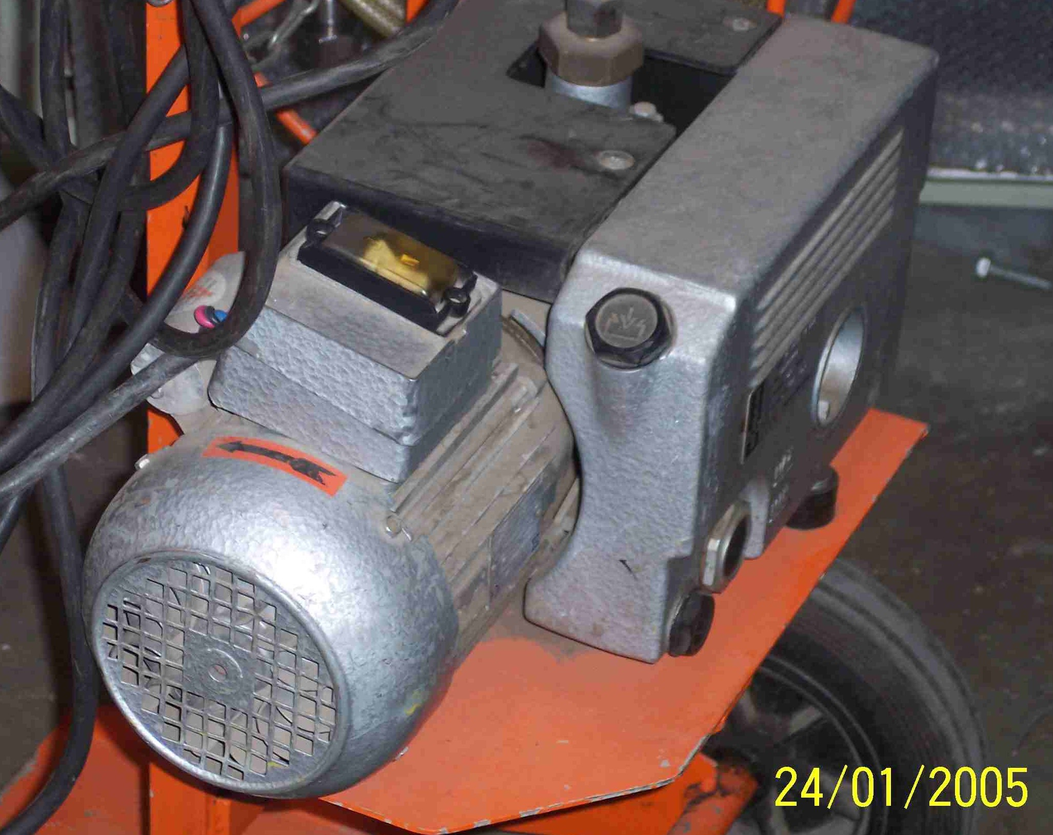
SIEMENS
HVCB SPARES
VACUUM PUMP
S4799188001

